Slide 1
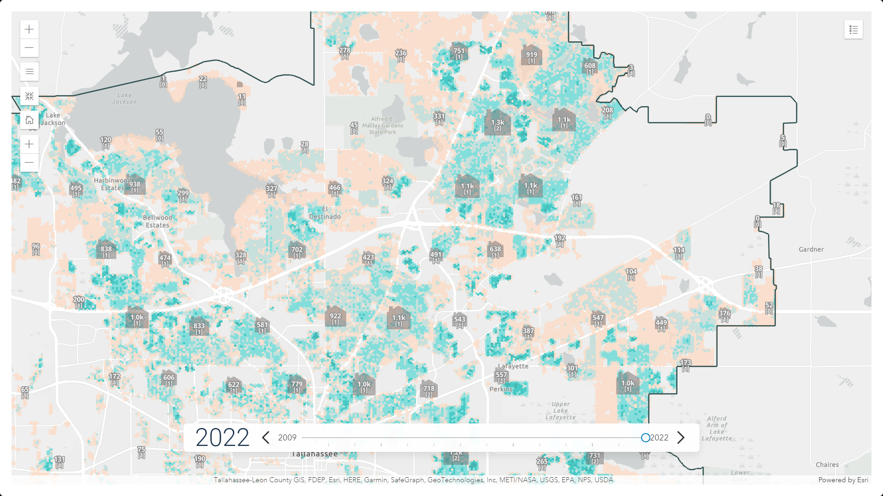
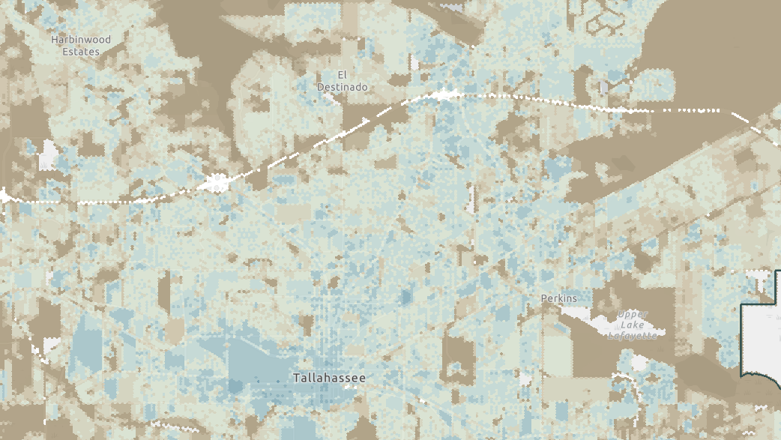
Hexagram Bin Analysis of Growth Trends Using Annual Parcel Data from Tallahassee, Florida 2009-2022
2023 SHRUG WORKSHOP
November 14
Notes:
Good afternoon & thank you for joining us this first day of the workshop.
​
Today I’ll be sharing a project to process & visualize 15 years of parcel data. It consists both of a python script to pepare the data and a custom web application for users to interact with it. ​

Slide 2
Overview
Motivation
What I hope you'll find useful
Process & lessons learned
Application walk-through
Notes:
I’ll start by talking about what motivated me to do this, what I hope you’ll learn, then I’ll walk though the app and wrap up with the process that went into creating it.​

Slide 3
Who am I?
25 years in land use planning
Recently completed MS in Cartography & GIS (U. of Wisconsin-Madison)
Notes:
This presentation today is actually on my final project for that degree.
Currently working in the City department that handles inspections & permitting for new development.​

Slide 4
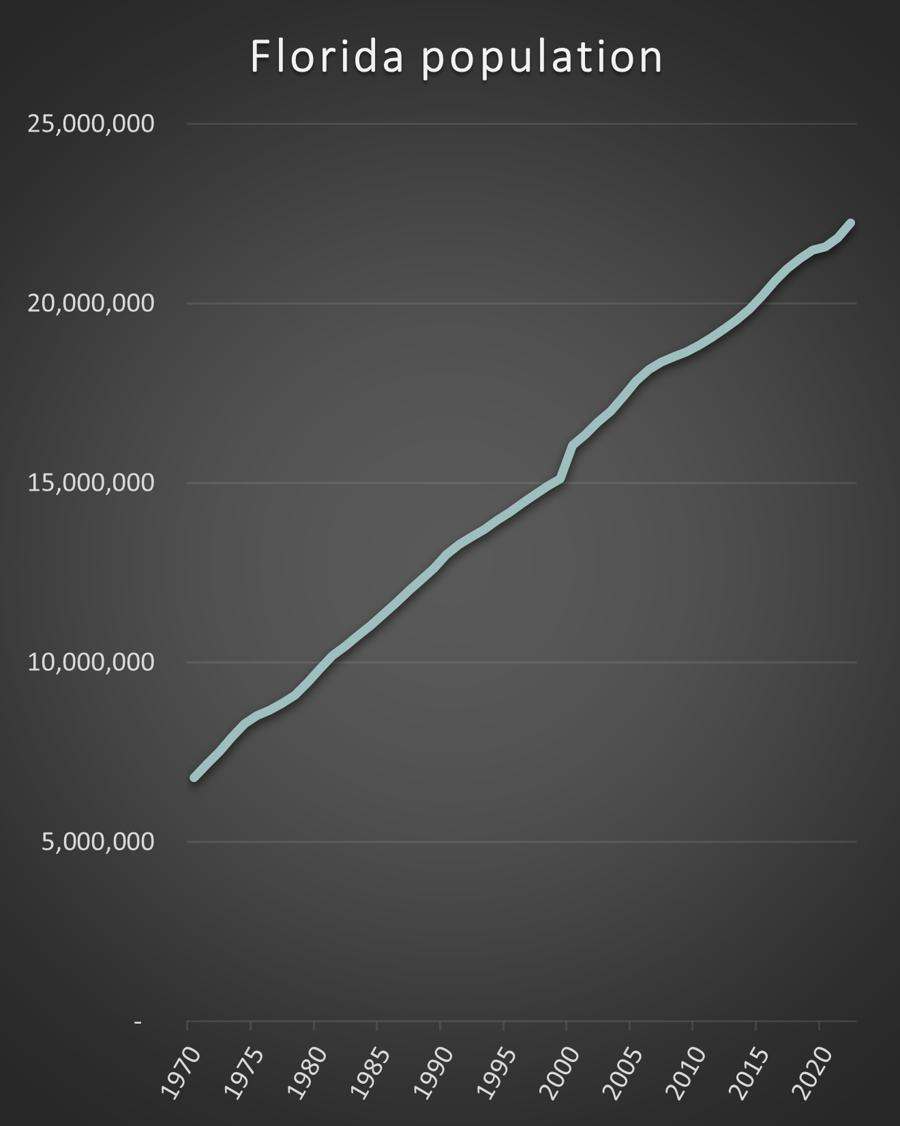
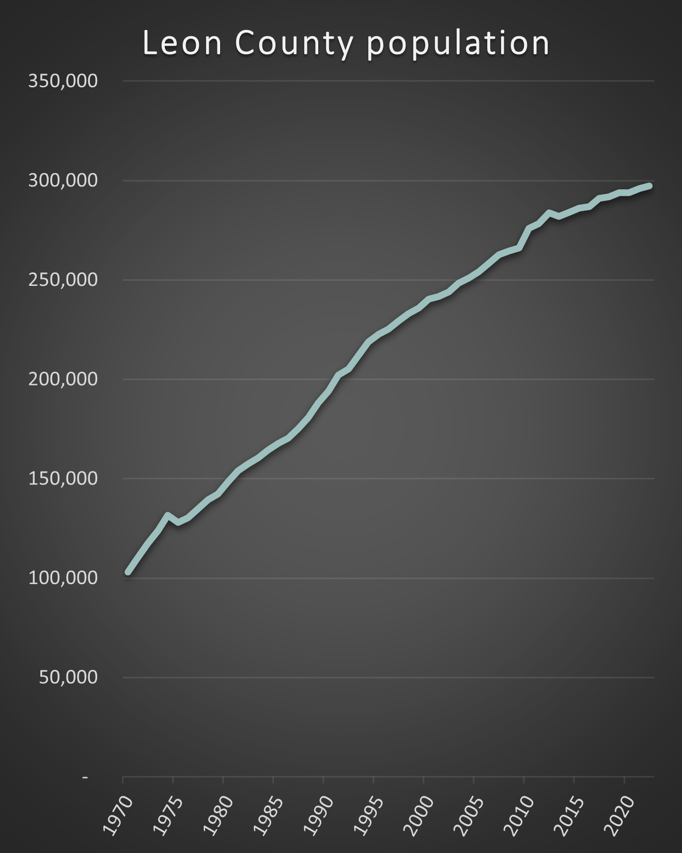
189%
228%
Notes:
Moving into the motivation behind the project, I live & work in one of the fastest growing states in the country.​
​
Here you see ….​
​
That compares to about 63% nationally during the same period. ​

Slide 5
Motivation
Population Growth
Measure progress toward Infill growth goals
Common ground & Collaboration
Environmental & fiscal sustainability
Notes:
While many agree environmental & fiscal sustainability are desirable, how you actually do inevitably complicated. ​
​
At the heart of urban planning is balancing often competing demands of environmental preservation, private property rights & providing an affordable supply owner & renter occupied housing. Honestly sometimes that feels impossible. ​
​
To start we need to be able to measure progress towards already adopted goals before we talk about changing them. ​
​
That’s one big reason I turned my career focus towards the data & tools – to help those competing stakeholders hopefully agree to what the historical data shows & thus give a head start on communication & collaboration.​

Slide 6

Project Goals
Residential units, home-ownership, nonresidential ft², valuation, & taxes
Primary land use, tree canopy cover & impervious roadway
Estimate greenfield acreage needed for projected population & amount of roadway to maintain
A tool to visualize changes over time for key policy topics using 15 years of parcel data

Slide 7

Project Goals
each year when new data is available
or when discover data can be cleaned or processed better
Python script for easy updates

Slide 8
The Data
One feature class for each year from the property appraiser (parcel boundaries, sales, sq. ft., valuation, taxes, home ownership, etc.)
Since 2009, the Planning Department updates the residential unit count for each parcel based on building & demo permits
Notes:
So you can see there is a rich database of data about development. ​
​
The problem is it was split over multiple years parcel boundaries change frequently. ​
​
Needed a method to spatially normalize the data without losing that richness of the parcel level data which could happen when using census tracts, even at the block group level.​

Slide 9
combine and/or
expand
subdivide
time

Slide 10
$650
$2200
$435
$1750
$1700
$1500
$3900
$2700
$800
$960
$725
$3000
$1010
Notes:
That’s where the binning process comes in. The SummarizeWithin Tool in ArcGIS Pro was used to assign the proportional values of parcel attributes that fall into each 1-acre bin. This was done for each year.
1-acre bins were used because the local zoning code measures residential density by units per acre allowed.

Slide 11
Fields for:
2009
2010
2011
2012
2013
2014
2015
2016
2017
2018
2019
2020
2021
2022
$650
Did this for:
residential units
homeownership
nonresidential ft²
valuation
prior year taxes
$435
$1750
$3900
$960
$725
$1010

Slide 12

What I hope you’ll find useful
Ways to manage & visualize multiple layers
Manage & visualize multiple data fields over time
Techniques to mine data from historic GIS records

Slide 13
Why a custom web application?
Simplify exploration of multiple layers & multiple fields
Easy for non-GIS user to explore
Dataset needed for out of the box time slider would be 1.5 million features…
Notes:
So that explains the purpose for massively reformatting the dataset, but why take the next step & do a custom web application? ​

Slide 14
Application Walk Through

Slide 15
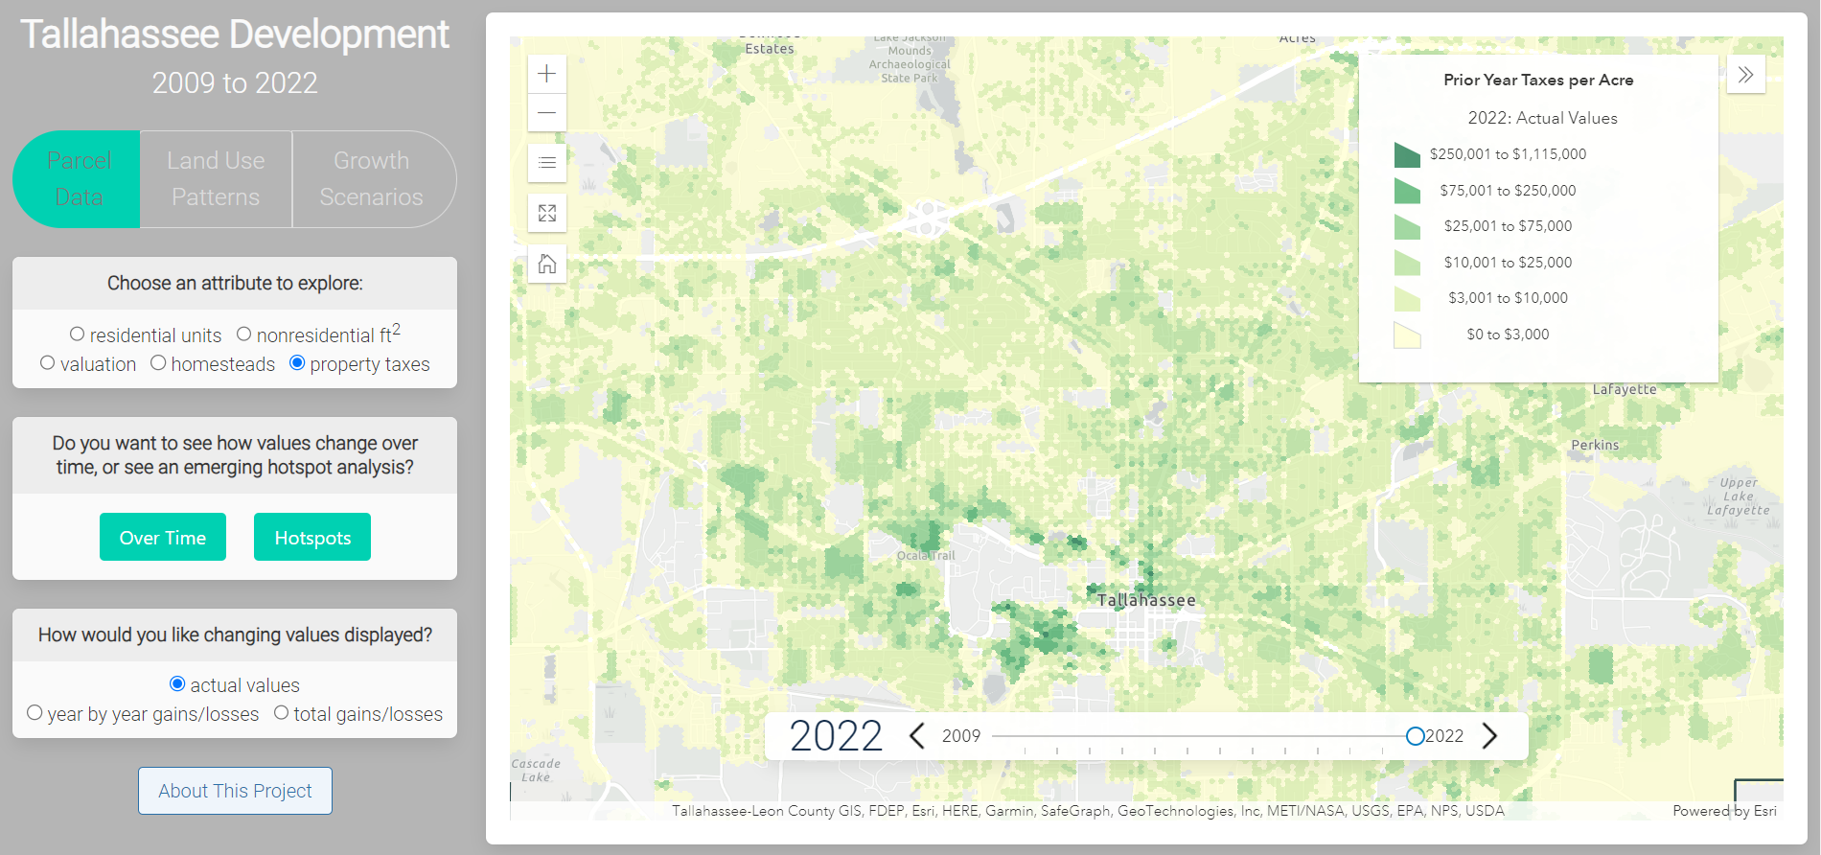

Slide 16
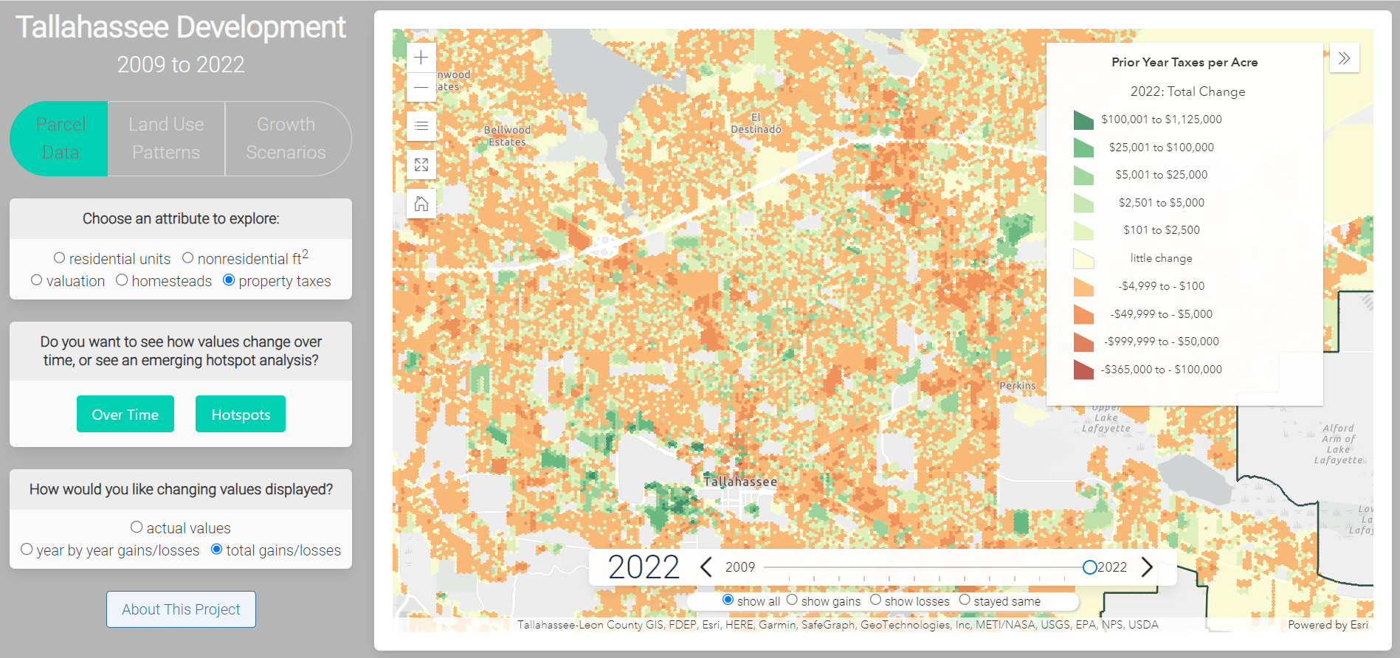

Slide 17
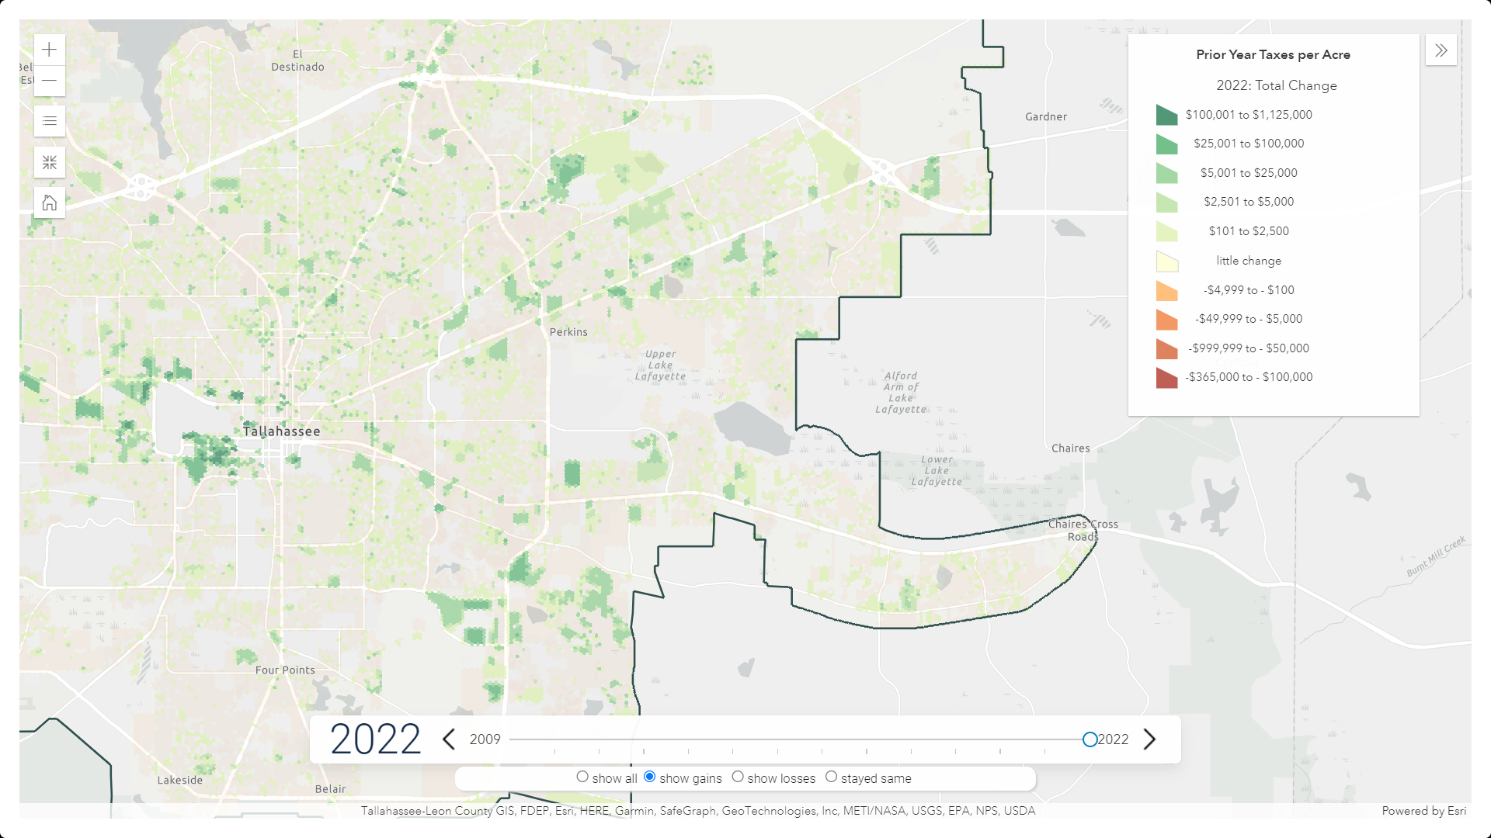

Slide 18
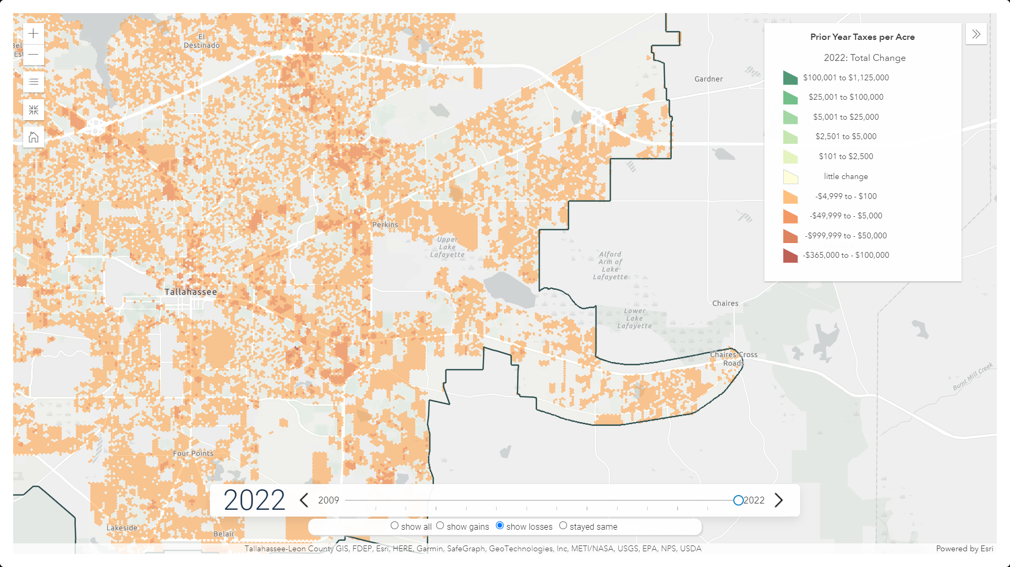

Slide 19
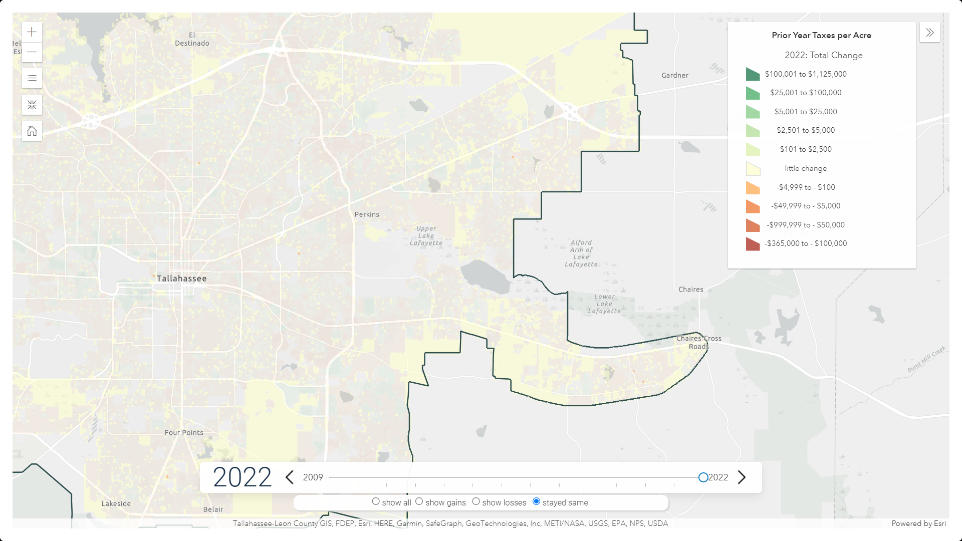

Slide 20
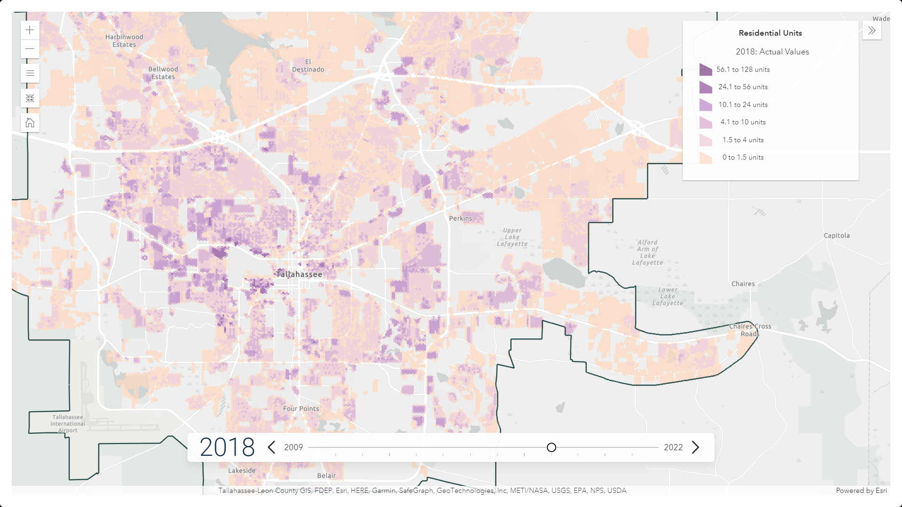
Notes:
From user interface point of view, wanted each tool to work seamlessly with each other so that was a coding exercise to solve.

Slide 21
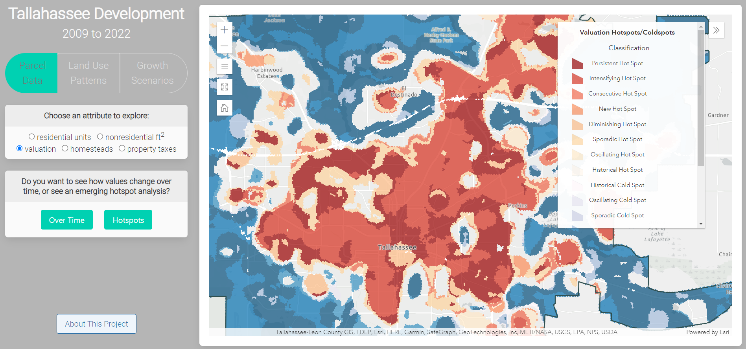
Notes:
+ placeholders for future phases.
+ plan to also add tab panel for indicators & popups for individual bin values

Slide 22
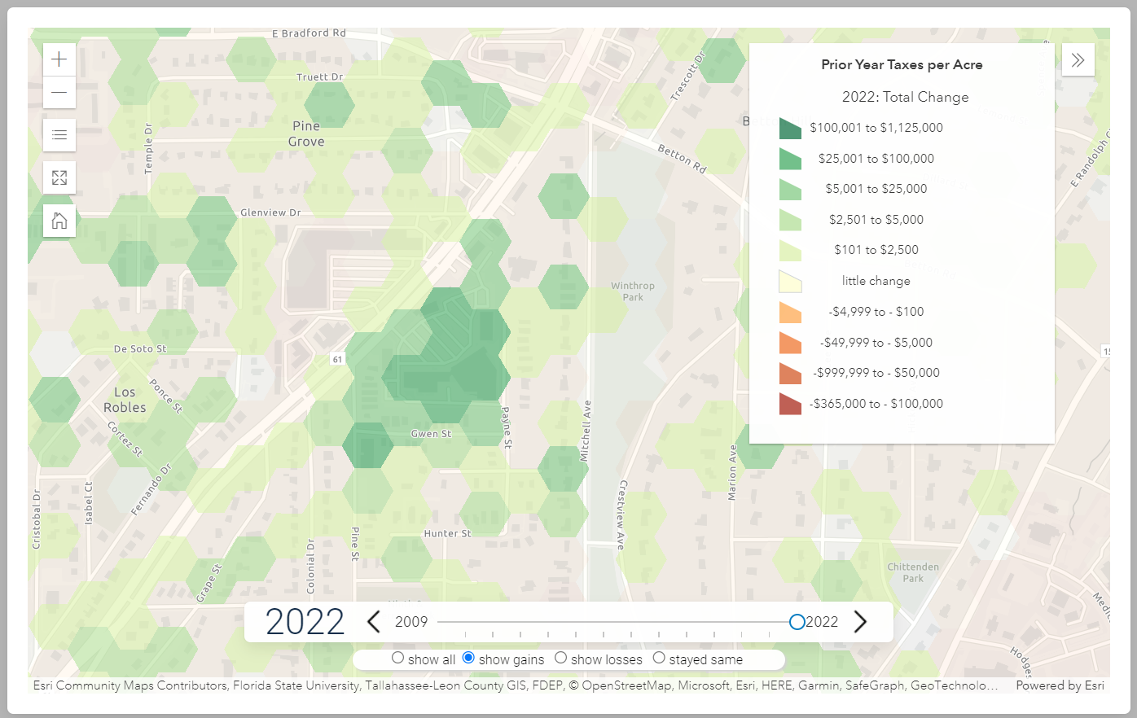
Whole Foods Rebuild
Notes:
These tools can be used to see impacts of policy decisions and investments.
Here we see where a mostly vacant and aging strip mall was replaced by a Whole Foods.

Slide 23
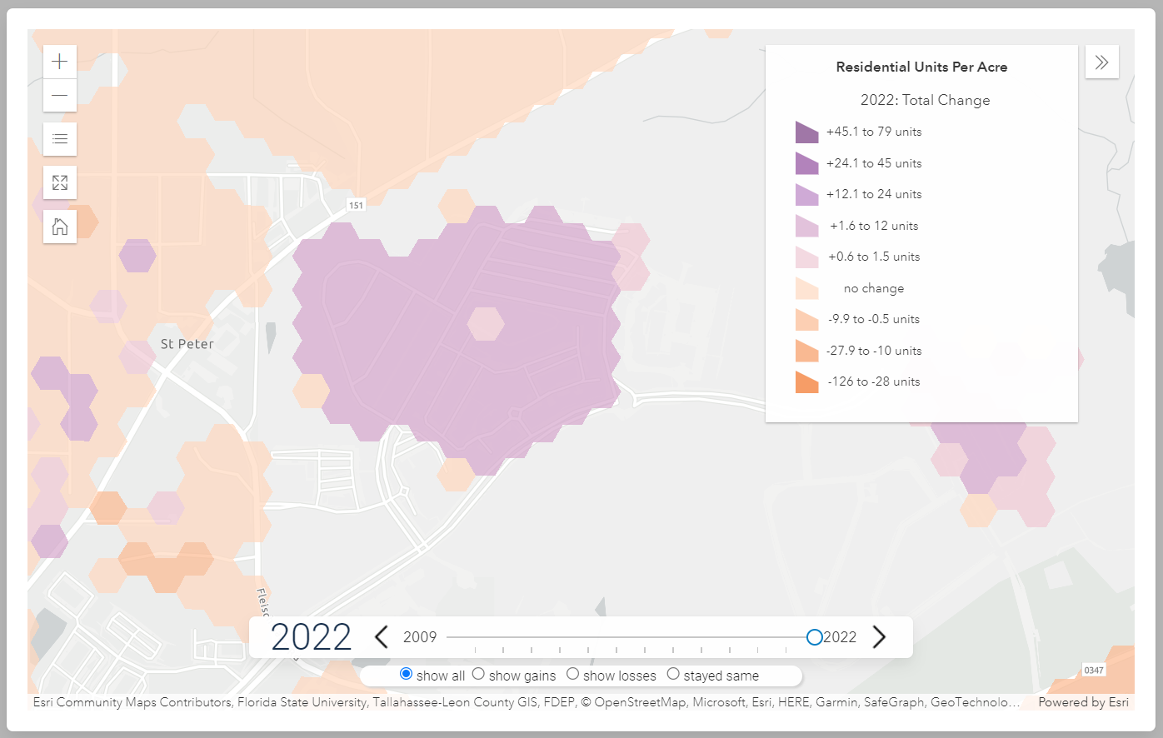
Rezoning to Allow More Houses & Apartments
Notes:
Here a rezoning was approved in greenfield land to allow homes & apartments.

Slide 24
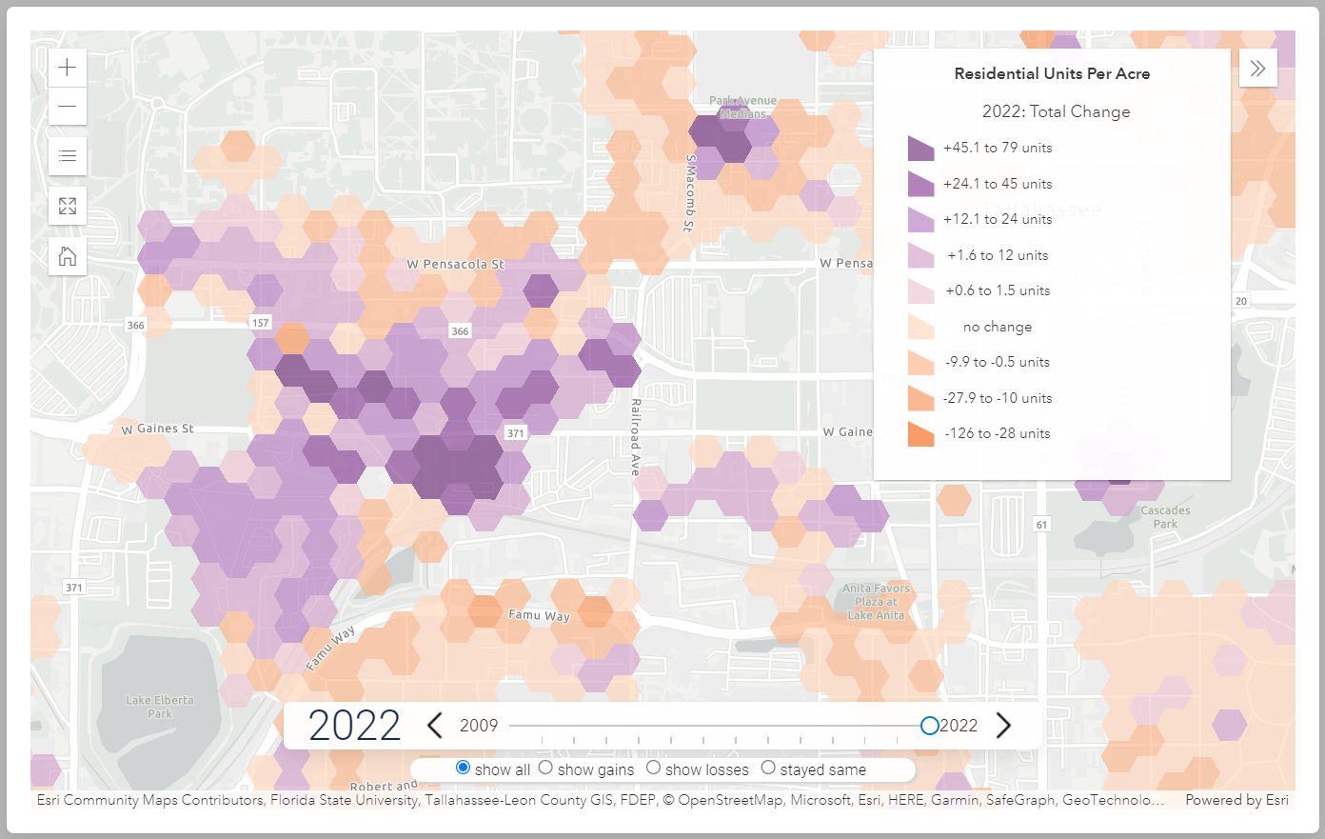
Conversion of Industrial to Walkable Street ➔ Many New Apartments
Notes:
And here a long term roadway & infrastructure project converted an industrial road near downtown into a pedestrian friendly area. We see many, many new apartments built since then.

Slide 25
Process

Slide 26
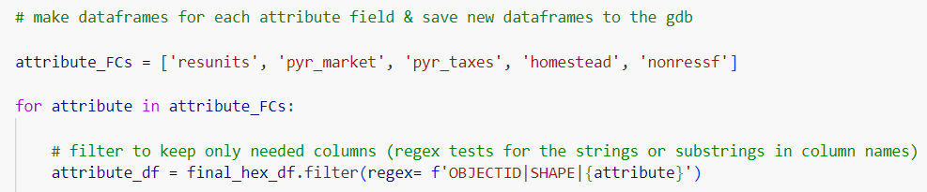
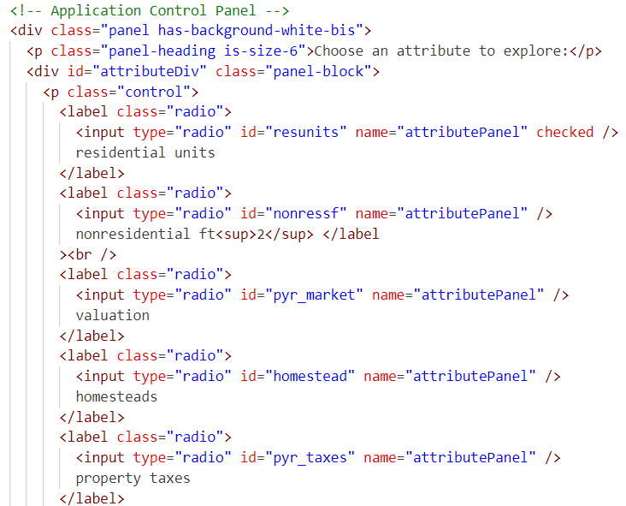
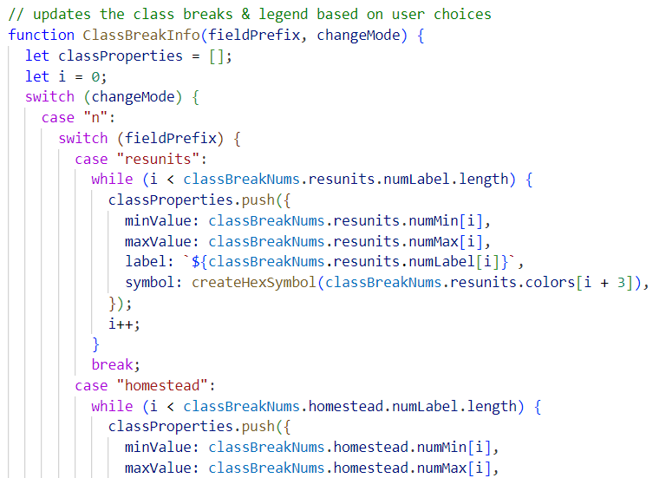
ArcPy (SummarizeWithin), Pandas, ArcGIS Python API (Spatially Enabled Dataframes)
Iterative – mapped out the JavaScript as I was writing the Python
Coordinate layer & field names with HTML & JavaScript to simplify coding and maintenance
Python
HTML
JavaScript
Preparing the Data
Notes:
Moving onto the process… Spatially Enabled Dataframes allowed me to cut my runtime in half, so I’ve included a link at the end if you would like to check it out.

Slide 27
Python Workflow
Clean
Account for changes in classification
New Fields
Calculate any new fields (non-residential sf & inflation)
Summarize
Summarize data within the hexagrams
New Fields
Calculate new fields for annual & total change
Separate
Separate into separate layers for each attribute of interest
Point Lyrs
Convert same data into point layers for clustering labels

Slide 28
ArcGIS Maps SDK 4.27 / JavaScript
Bulma CSS Framework
Building the Application
Notes:
Since our ocal government is part of the ESRI ecosystem it made sense to use the ArcGIS Maps SDK.​
Bulma is a framework that simplifies styling and building responsive mobile applications. I saw an article about it and just wanted to try it out as an alternative to Bootstrap.

Slide 29
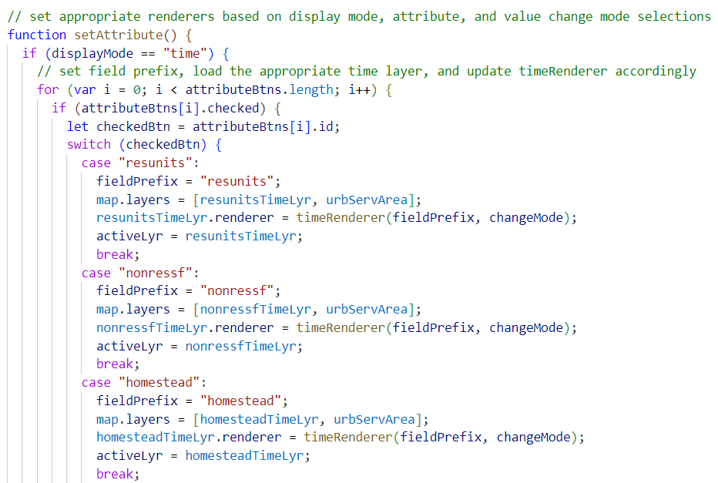
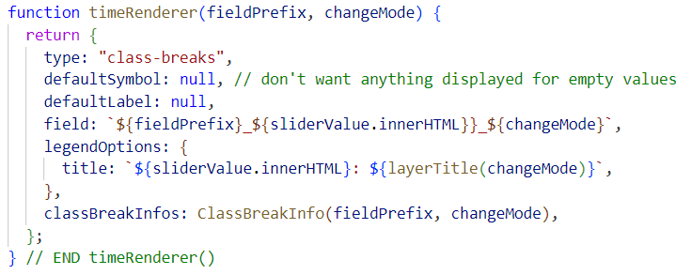
Challenge
Making several user input elements work smoothly together
Notes:
Solved this by using global variables to set the state of application when the user makes a choice so that it applies to all the other event listeners. ​
​
This was facilitated during the data processing step by naming the layers, fields & radio buttons in a coordinated way as I mentioned a couple of slides back.​
​

Slide 30
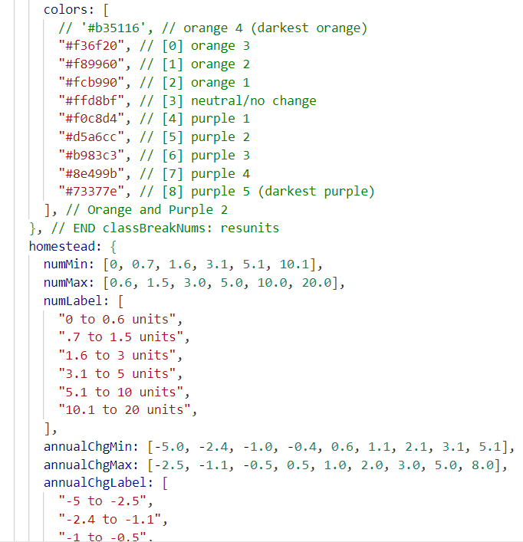
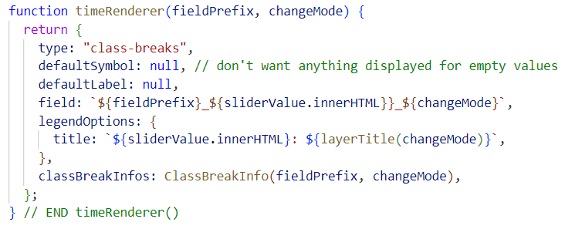
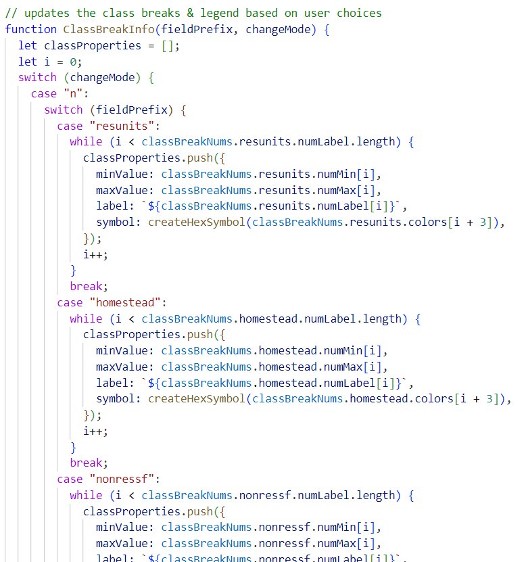
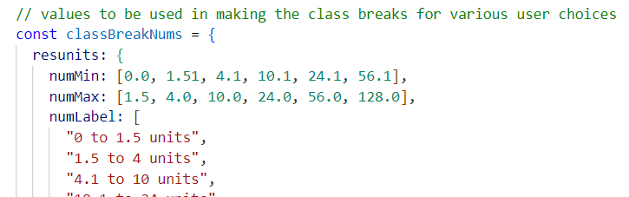
Challenge
10 layers & multiple FIELDS WITHIN EACH LAYER
Notes:
Rather than creating 20 or more different renderers, had only 2 – one for time series & one for hotspots.
The time renderer was most complicated, so I relied on a JavaScript object that stored all class break values & colors. This allows adjustments to be done all within one block of code, making for much easier fine tuning and maintenance over time. I used that and switch statements to feed the actual renderer function.

Slide 31

Lessons Learned
Break into layers for each attribute (number of units, prior year taxes, etc.)
Data categorization can change data over time:
Nursing homes were counted as multifamily in early years, but not later
Conversions from townhouses with large common areas (all as separate parcels) ‘tricked’ my python script into thinking units had been gained in some hexagram bins & lost in others.
Notes:
Did whole project, turned it in so I could graduate, then recoded everything based on lessons learned for better performance, more intuitive UI & easier maintenance
I’ve since updated the python script to account for the first two & will do the same for the third.
This is the benefit of having the python script – once the adjustments are made, it’s simple to update all the resulting feature classes.

Slide 32
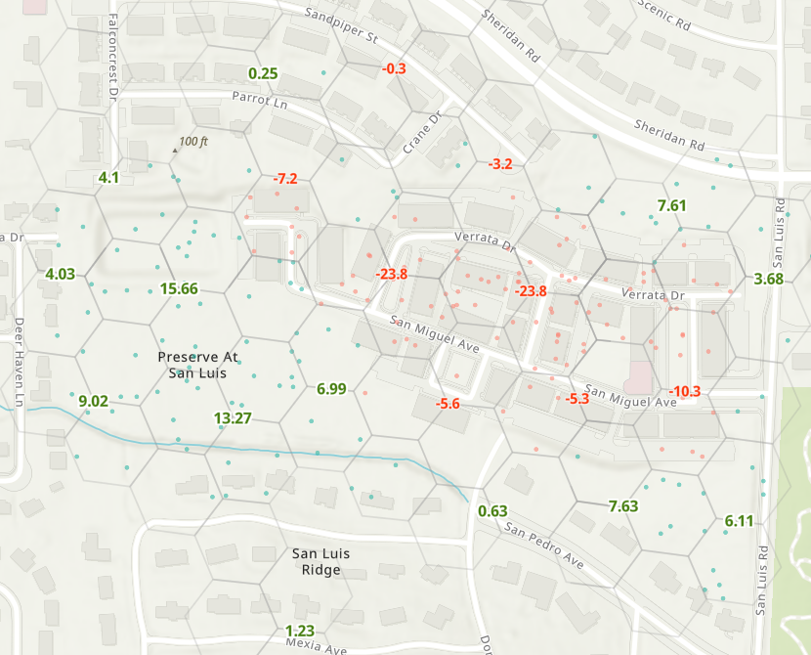
Many townhouse/condominium parcels
+
separate greenspace parcels
Were combined into a single, multifamily parcel
Notes:
Went back to the initial year (2009) and looked for parcels that had both townhouse/condo and open space under the same owner name, then overlaid each subsequent year on these to see if any changes in parcel boundaries had occurred. This revealed about 10 instances over the 14-year period where this happened. Keep a separate feature class of these parcels so I can then account for those needed adjustments in the Python script prior to splitting the parcel data into the bins.

Slide 33
Lessons Reminded
Importance of working with peers knowledgeable of the data
Notes:
Did whole project, turned it in so I could graduate, then recoded everything based on lessons learned for better performance, more intuitive UI & easier maintenance
I’ve since updated the python script to account for the first two & will do the same for the third.
This is the benefit of having the python script – once the adjustments are made, it’s simple to update all the resulting feature classes.

Slide 34
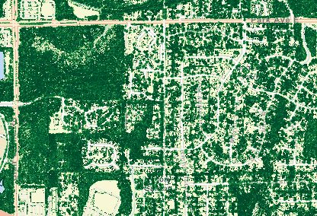
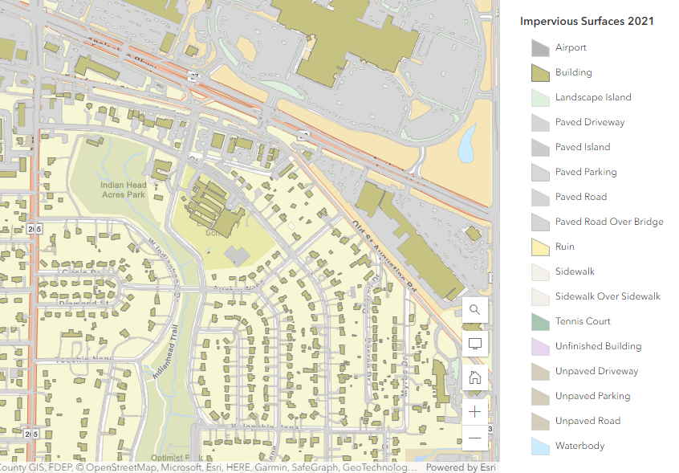
What’s next?
Use impervious surface & canopy cover data to see relationships to relating density & land uses
Let user see how much land is necessary to support future population estimates based on potential development patterns
Outside of the web application, the dataset itself can be useful in other applications, such as looking at homeownership & valuation patterns based on neighborhood associations, special planning areas and demographics

Slide 35
Resource links
Application (Still under development & doing data cleaning): https://cybryant.github.io/LeonParcelTimeAnalysis/
GitHub repository with code: https://github.com/cybryant/LeonParcelTimeAnalysis
Bulma: bulma.io
Spatially Enabled Dataframes: https://developers.arcgis.com/python/guide/part1-introduction-to-sedf/
Feel free to reach out!
cherie657@gmail.com or cherie.bryant@talgov.com
(850) 879-8391 (work mobile)
Linked In

